Slide 1
Scrapping GitHub website data and knowledge graph creation
Chandan Sharma

Slide 2
Project Overview
Objective: We wish to extract data from the GitHub’s repositories and create a knowledge graph for supporting analysis and building future recommendation system for GitHub users.
Methodology: We want to extract users contributing to specific repositories and find their followers.
In order to do so we use the Extract-Transform-Load design pattern.
In order to create a knowledge graph we use the Neo4j graph database.

Slide 3
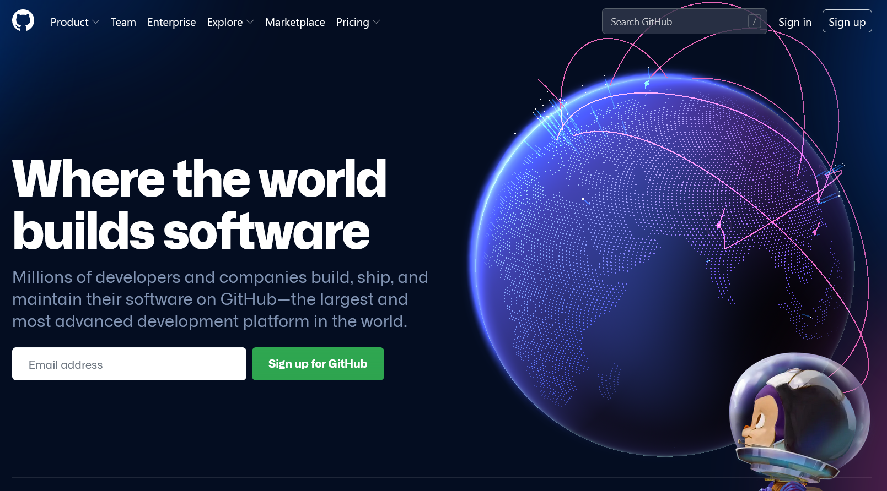
GitHub case study Overview
GitHub is an internet hosting service which provides support for software development and version control.
Multiple users (developers) can use this to collaborate and version control their projects.
As such there are multiple central themes to which users can contribute to

Slide 4
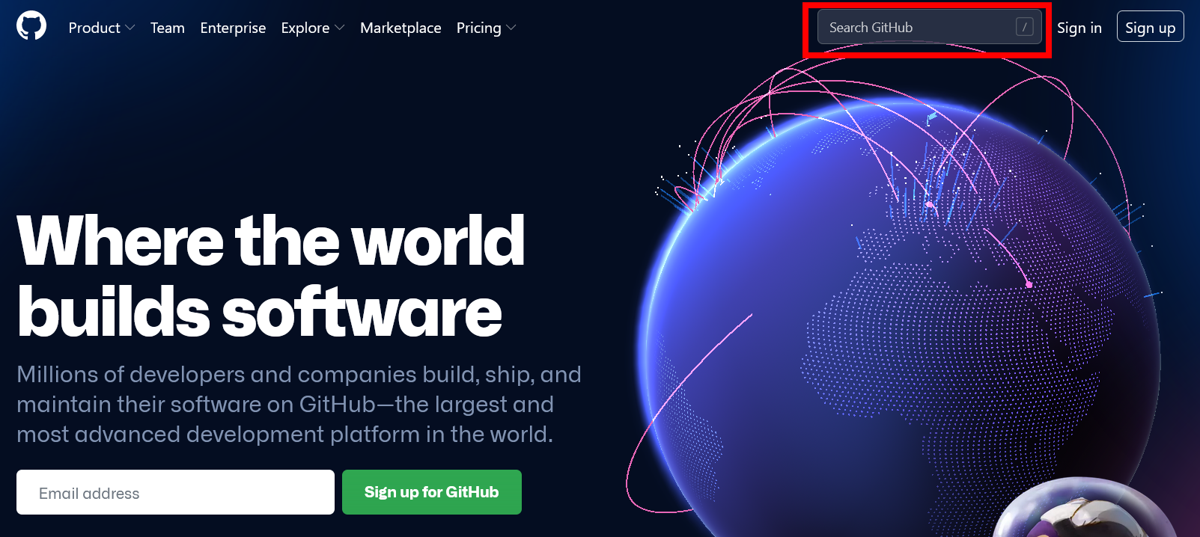
We can use the “Search GitHub” search bar for searching a theme under which certain repositories are grouped together.

Slide 5
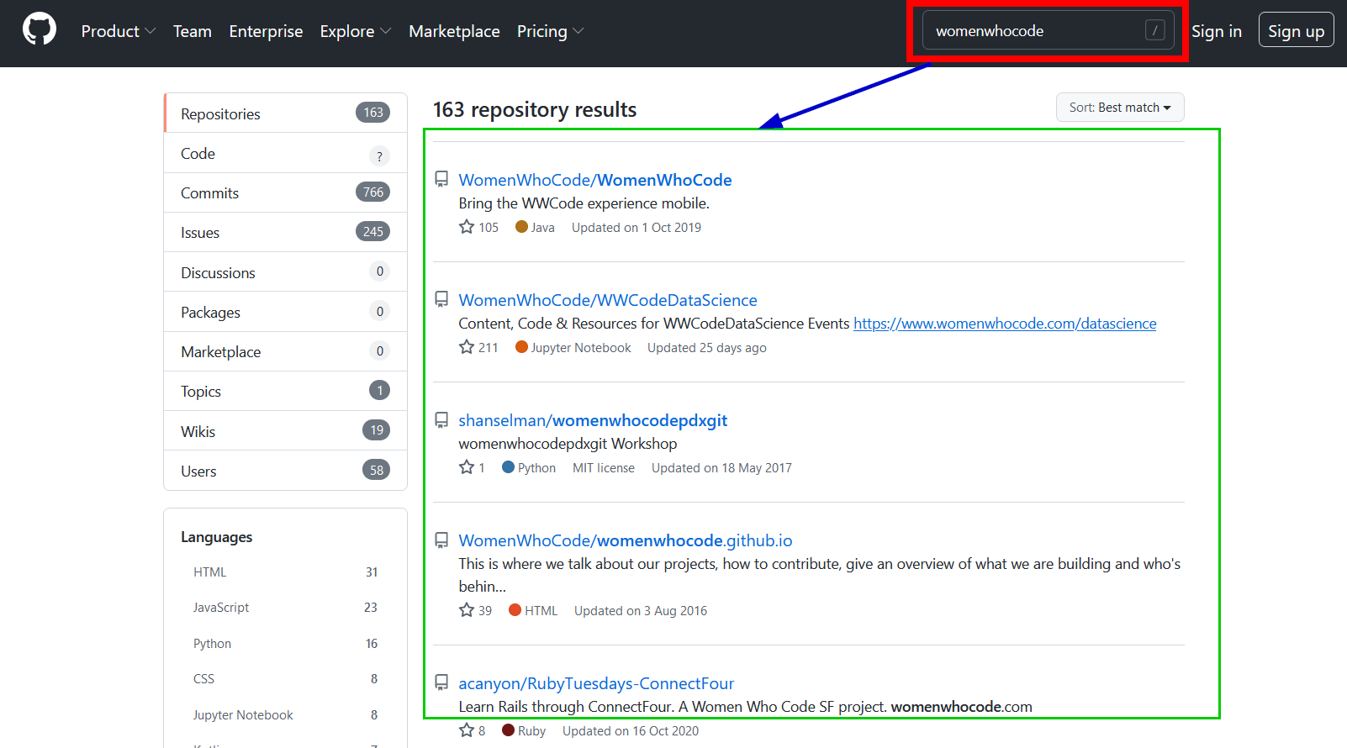
Searching for a theme “womenwhocode” gives us a total of 163 repositories.

Slide 6
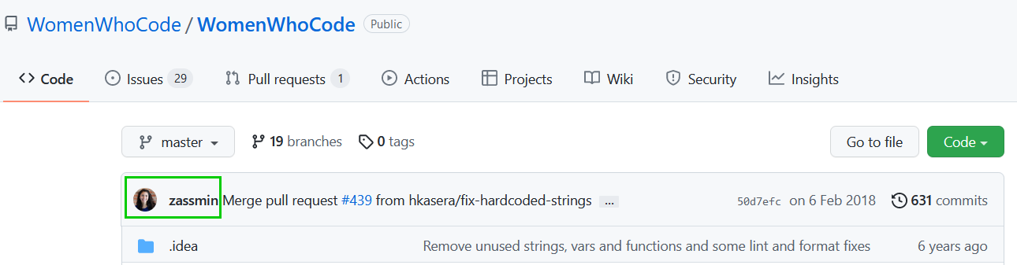
For the sake of simplicity we want to find out only the last person that committed to the project.
As shown in the image we know that person is zassmin.

Slide 7
Problem Formulation
As a user who is using the GitHub website.
We can observe that the webpage are linked to one another.
A user can navigate to different pages by clicking on the hyperlinks.
Intuitively we can think of these pages having some relationships with each other.

Slide 8
REPOSITORY
THEME
Is part of
Contributes to
USER

Slide 9
Project objectives revisited
In this project we wish to obtain this data from the GitHub website.
Convert this data in a machine readable format.
Model this data as a graph database.
Why a graph database.
Why graphs!!!!

Slide 10
Why Graph and Graph Databases ?
Graphs provide a natural and intuitive way of modeling highly connected data.
Data can be modeled as humans think of them.
For example,
A user contributed to a repository
A repository is part of a theme
Graph database solutions such as Neo4j provide means to store data as a graph.
By modeling data as a graph we can use powerful graph algorithms such as community detection, centrality detection for data analysis.

Slide 11
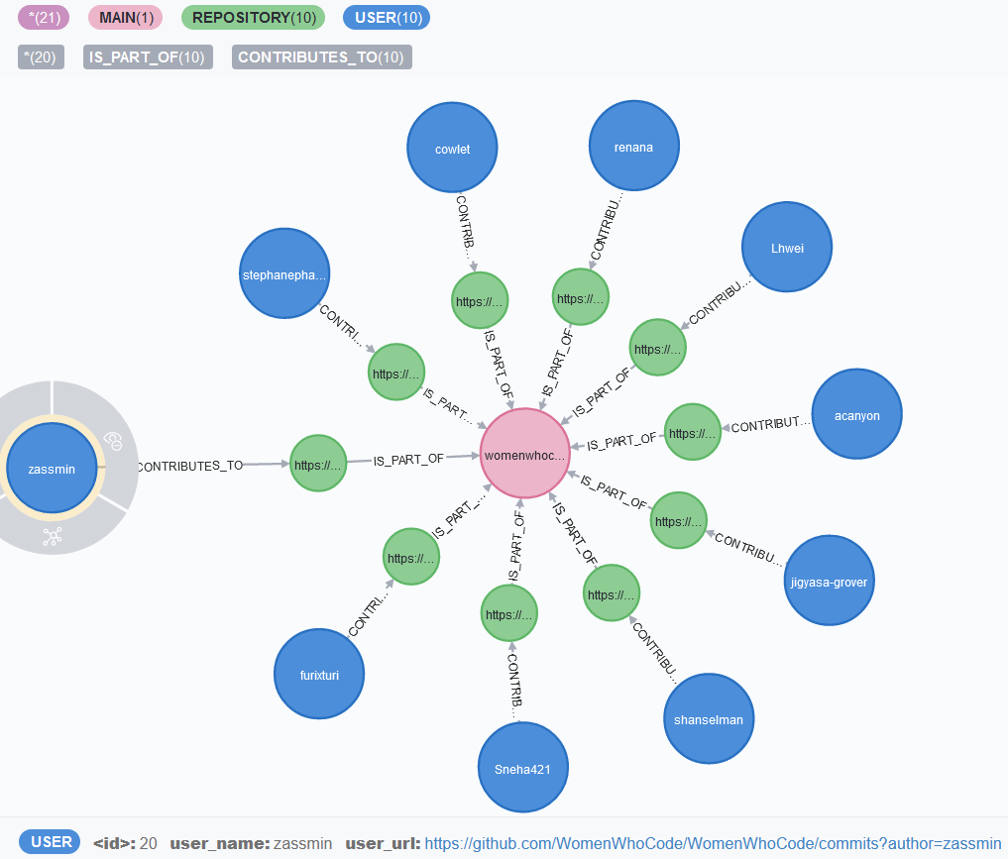
GitHub graph database : Our end goal
By the end of this project we wish to:
Create a GitHub graph database
The graph database is based on Labeled Property Graph Data Model
In this graph we have meta data stored inside nodes and edges as Key-Value pairs.

Slide 12
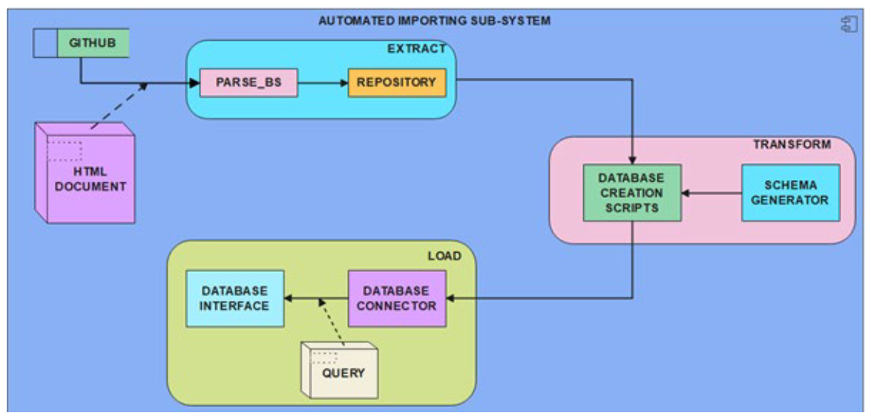
Software architecture
In order to create this project we will use the Extract-Transform-load design pattern.
The diagram shows the flow of the software by using an UML Data Flow Diagram.

Slide 13
Software architecture
The first stage is the Extract module which is used to obtain data from GitHub website.
The input is an HTML document and the extract module has two important components
Parse_BS and Repository

Slide 14
Software architecture
The second stage is the Transform module.
In this module database creation scripts are created based on the input obtained from the Extract module.
We also use a separate module called as schema generator
But a schema generator module is an advanced topic.

Slide 15
Software architecture
The third and last stage of the software lifecycle is the Load module.
This module gets the database creation script from the transform module as input.
This module forms a connection with the graph database and executes the database creation script.

Slide 16
Getting started with the Extract module
The Extract module also has objectives.
Objective 1: To fetch data from the GitHub website based on a particular Theme.
Objective 2: Once the data has been fetched we wish to scrap the html page.
Objective 3: The final objective of the Extract module is to create a repository or a staging area.
This staging area can then be used to provide input to the Transfrom module.

Slide 17
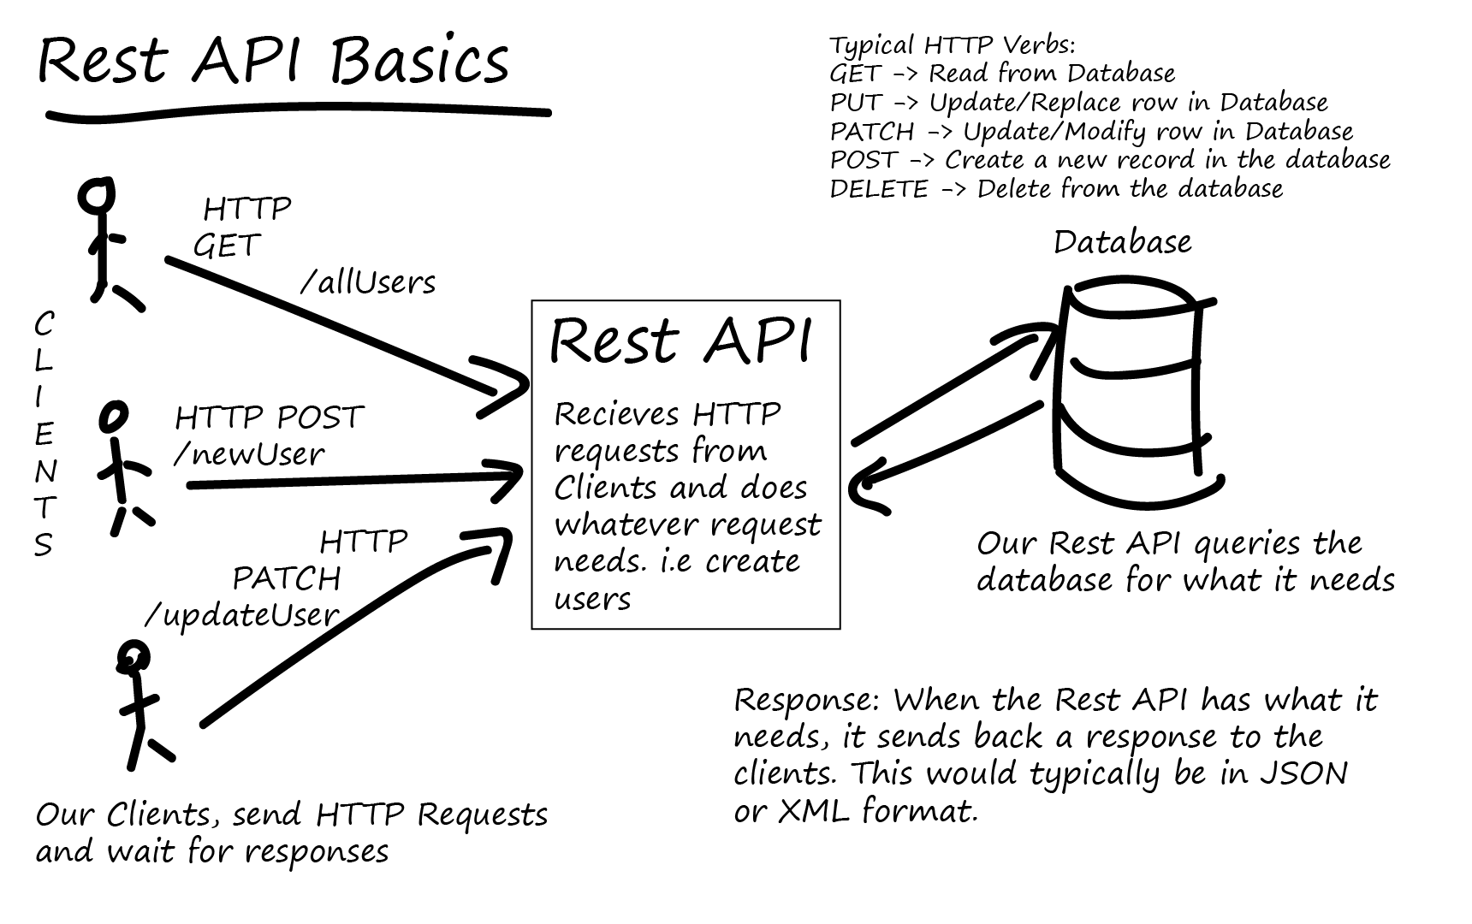
Extract module: Objective 1
We use the RESTFUL API for fetching data from the GitHub Website.

Slide 18
Objective 1 fulfilment: GET Request
In order to fulfill the objective 1 we require the RestAPI Get method.
GET request:
Is used to retrieve resource representation/information only
Not modify the data in any way
As GET requests do not change the resource’s state, these are said to be safe methods.
GET APIs are idempotent.
Making multiple identical requests must produce the same result every time until another API (POST or PUT) has changed the state of the resource on the server.

Slide 19
Objective 1 fulfilment: GET Request Response Code
For any given HTTP GET API, if the resource is found on the server, then it must return HTTP response code 200 OK
Along with the response body, which is usually either XML or JSON content (due to their platform-independent nature).
In case the resource is NOT found on the server then API must return HTTP response code 404
Similarly, if it is determined that the GET request itself is not correctly formed then the server will return the HTTP response code 400 (bad request)

Slide 20
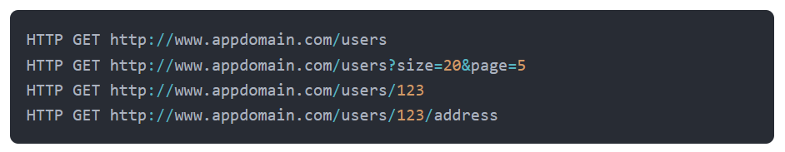
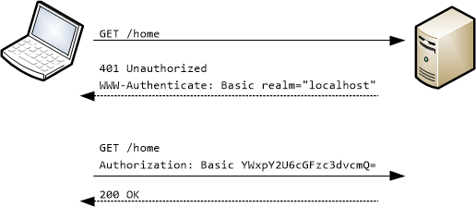
GET Request examples

Slide 21
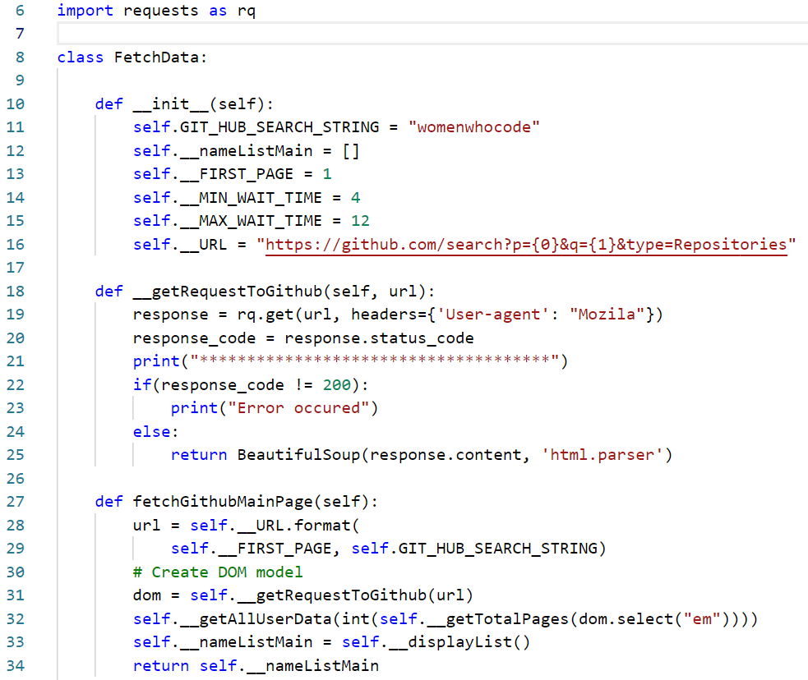
Project code for GET Request
In the code we import the requests module in line 6. This module is used to send RESTFUL web requests from Python code.
In line 18, we the calling the static get method provided by request library.
This method takes the url that we wish to search for and a dictionary of headers as input.
Incase the request code is 200 the method returns an HTML page

Slide 22
Quick recap: Observe the code and answer the questions
Before moving ahead let us take a few moments to analyze the code.
What can be observe??
What does self.__URL represents.
How is the self.__URL string being formulated??

Slide 23
Project code for GET Request
As shown in line 22-25 incase the request code is 200 the method returns an HTML page.
The get method returns result set in form of a JSON file.
We need to convert this page into a HTML format so that we can scrape the GitHub HTML page.
Hence we require another python library called as Beautiful soup.

Slide 24
Web scraping in Python: Beautiful soup
Beautiful soup is a Python library for pulling data out of HTML and XML files.
It works with your favorite parser to provide idiomatic ways of navigating, searching, and modifying the parse tree.
It commonly saves programmers hours or days of work.
For this project we are using Beautiful soup for pulling data out of HTML page.
pip install beautifulsoup4

Slide 25
Web scraping in Python: HTML
HTML : Hyper Text Markup Language
HTML is a structured language that is used to describe and formulate the structure of a web page.
HTML comes from a long history of markup languages such as
GML
Generalized Markup Language
SGML
Standard Generalized Markup Languages
XML
eXtensible Markup Language

Slide 26
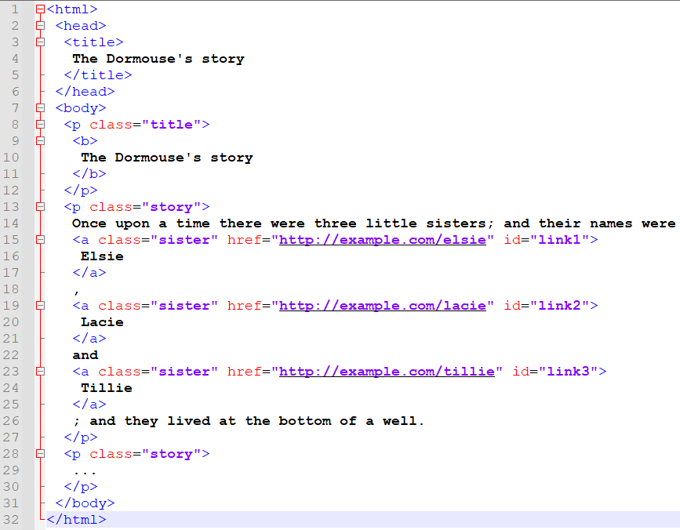
Given a simple HTML document.
We can use beautiful soup for pulling data out of the HTML page.
Beautiful soup library in python reads the entire HTML document
And provides methods to access the data based on the HTML tags.

Slide 27
Given a simple HTML document.
We can use beautiful soup for pulling data out of the HTML page.
Beautiful soup library in python reads the entire HTML document
And provides methods to access the data based on the HTML tags.

Slide 28
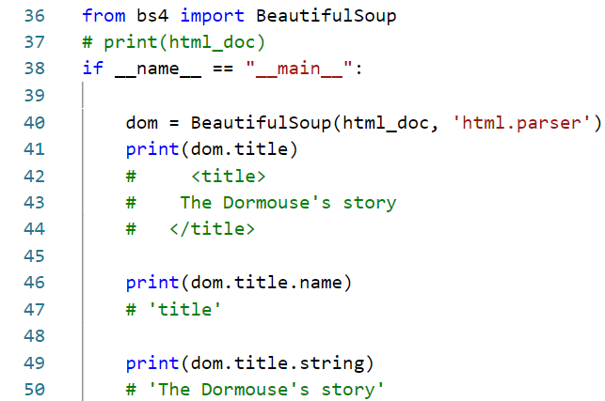

Slide 29
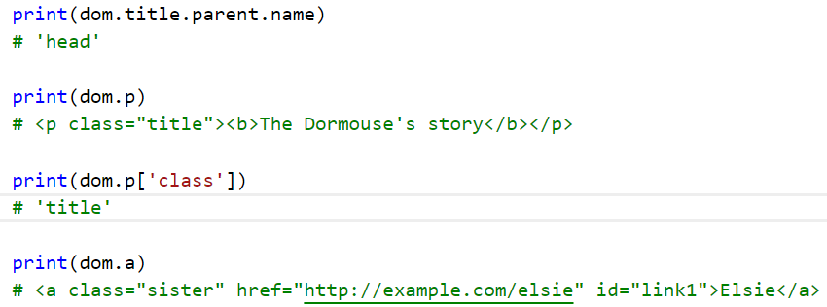

Slide 30
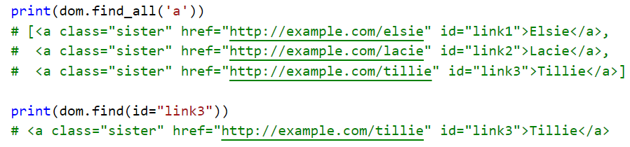

Slide 31
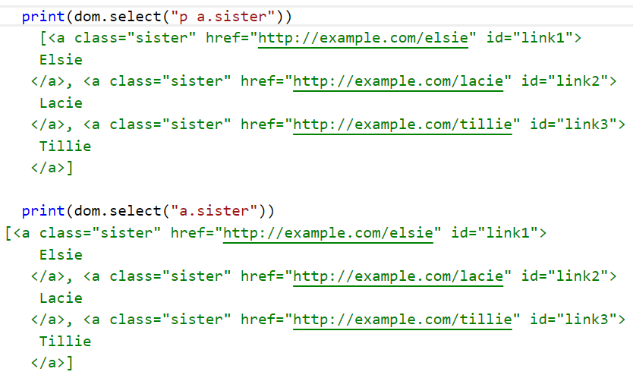

Slide 32
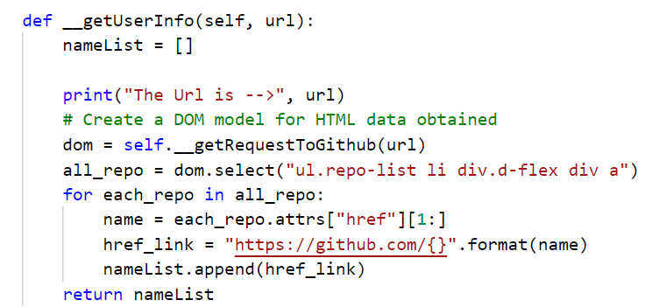
Extract module: Objective 2
The method __getUserInfo(self, url)
Uses the select method to search for the repository names.
But in the search string a pattern has been specified.
The pattern is used to search for the repository names.
But why???

Slide 33
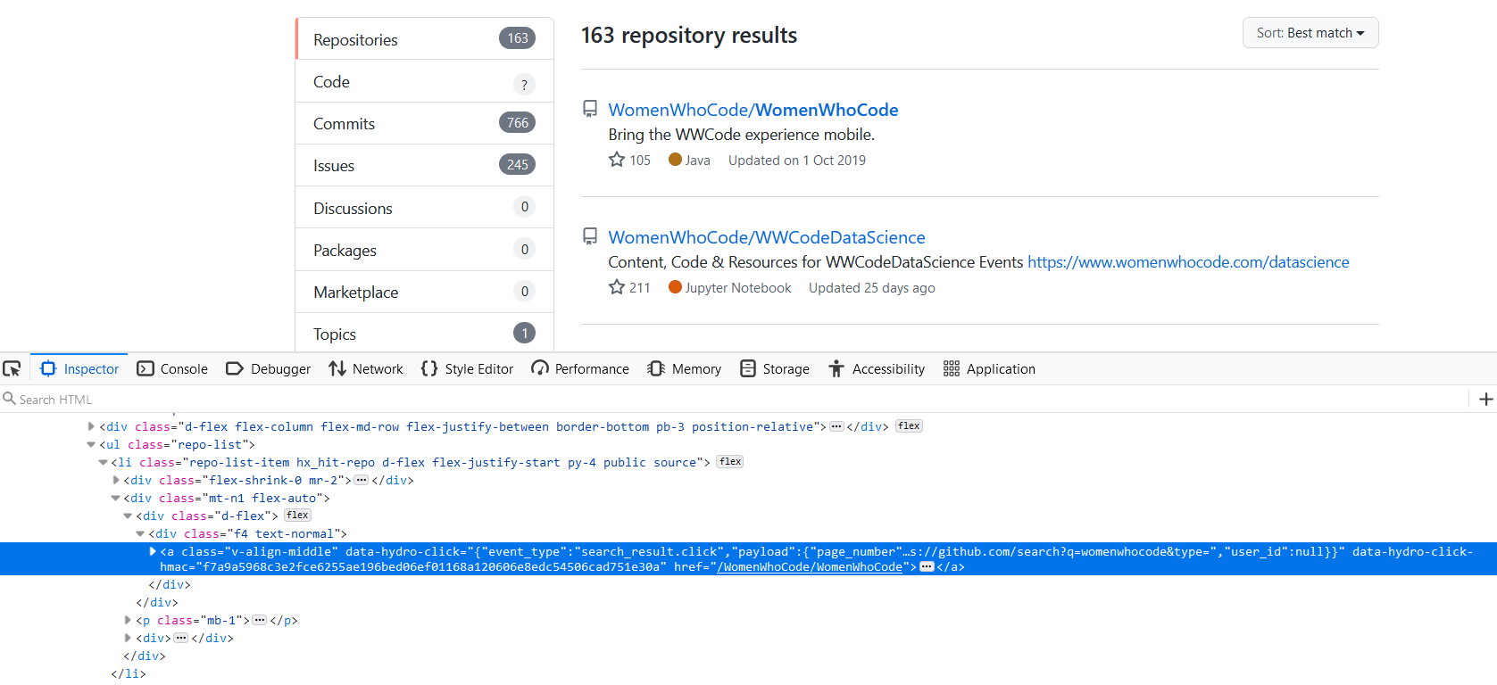
If we inspect the HTML source code behind the link “WomenWhoCode/WomenWhoCode”
We can observe that the link in embedded inside the ul → li → div → div → a tag.

Slide 34
Extract module: Objective 2
The code here is actually doing the same thing.
The dom variable is used to store all the tags that follow the hierarchy.
Then we are iterating over the all_repo variable which holds a list.
We are only interested in finding the contents associated with the href attribute.

Slide 35
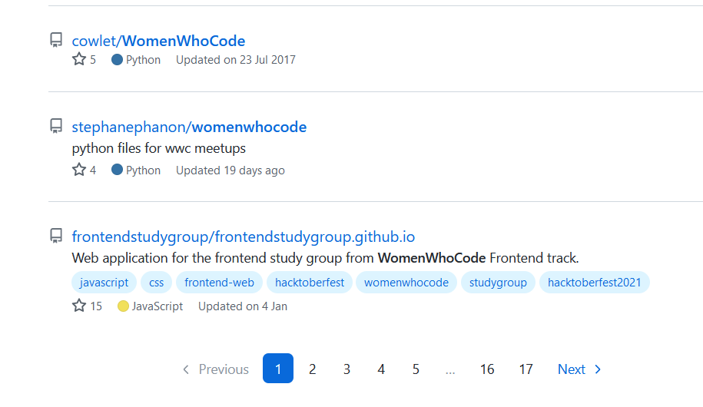
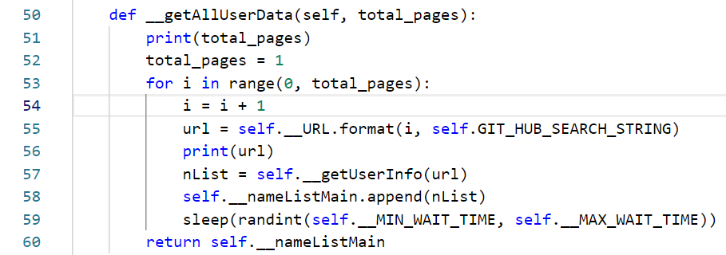
Randint function and logic to extract all pages
There exist multiple pages containing information about various repositories.

Slide 36
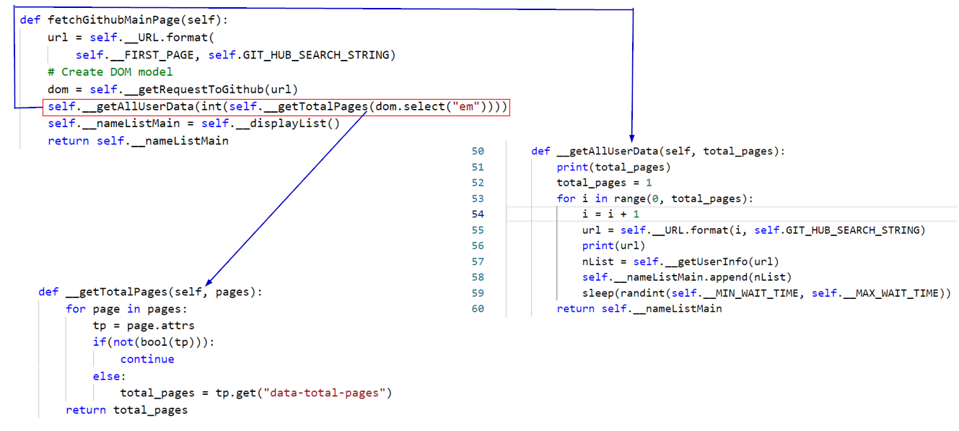
Randint function and logic to extract all pages

Slide 37
Randint function and logic to extract all pages
We need to put an interrupt while scraping data from multiple webpages on GitHub.
That is why we need a Randint function.
This function generates a random number between 2 and 8
The for loop after fetching data from one page holts for a while.

Slide 38
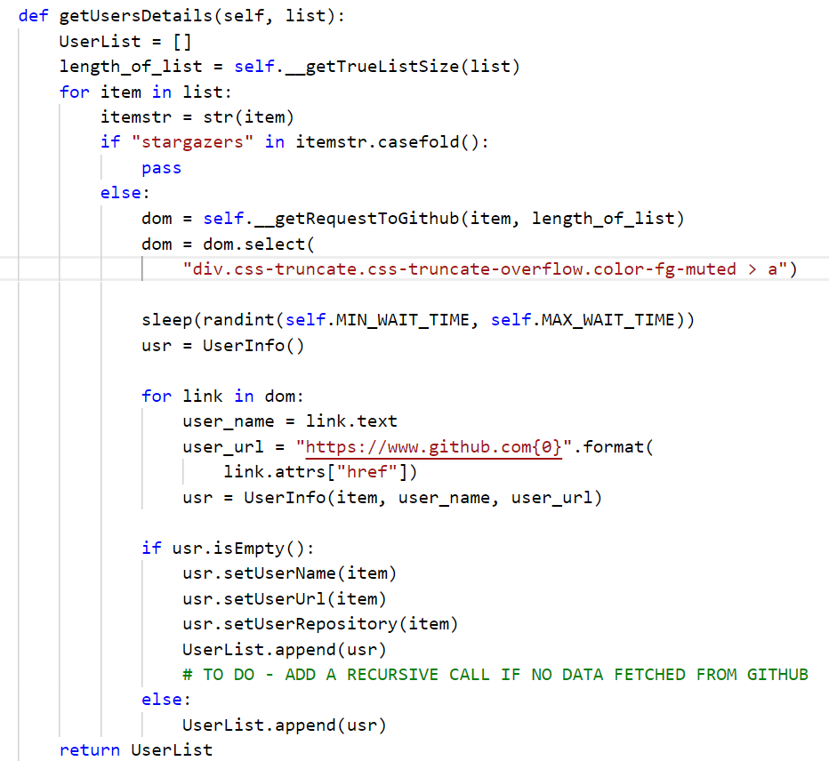
Extract Module: Objective 2 → Fetch user data
We now wish to fetch user specific data.
In this code we are not looking at the stargazers repository.
We are using the same logic for searching the element in the HTML document.

Slide 39
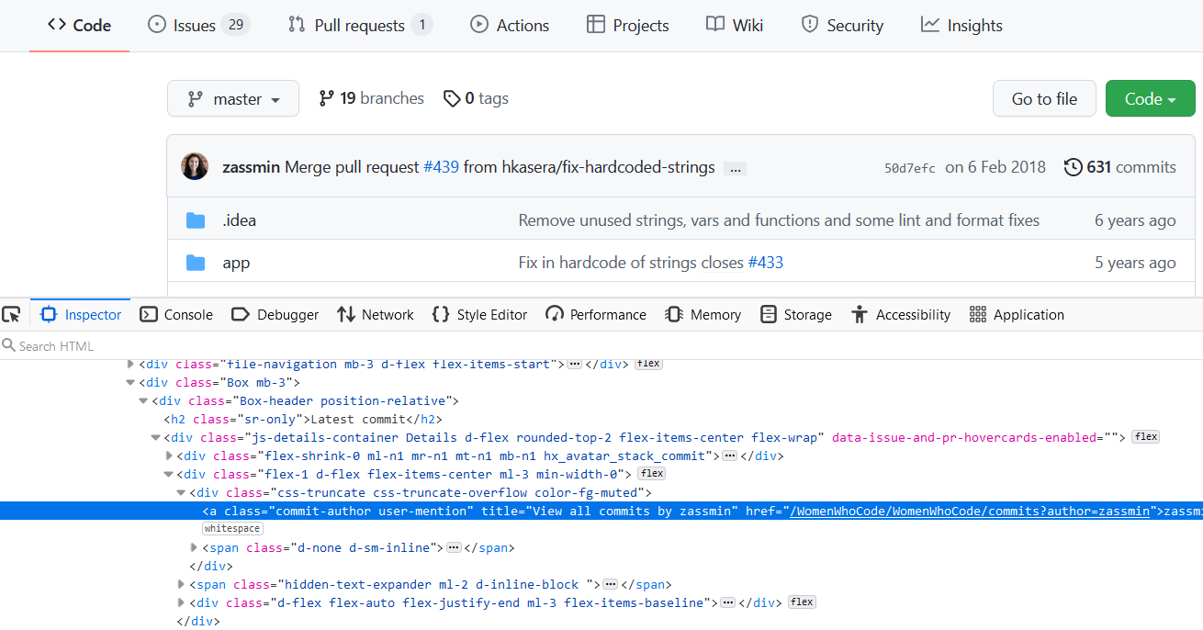

Slide 40
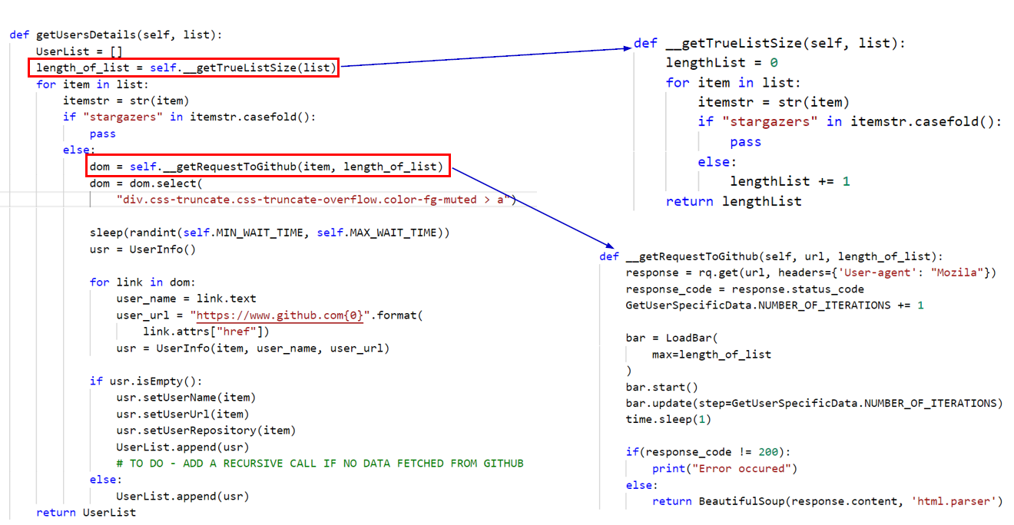
Discussion: Let us try to understand the code

Slide 41
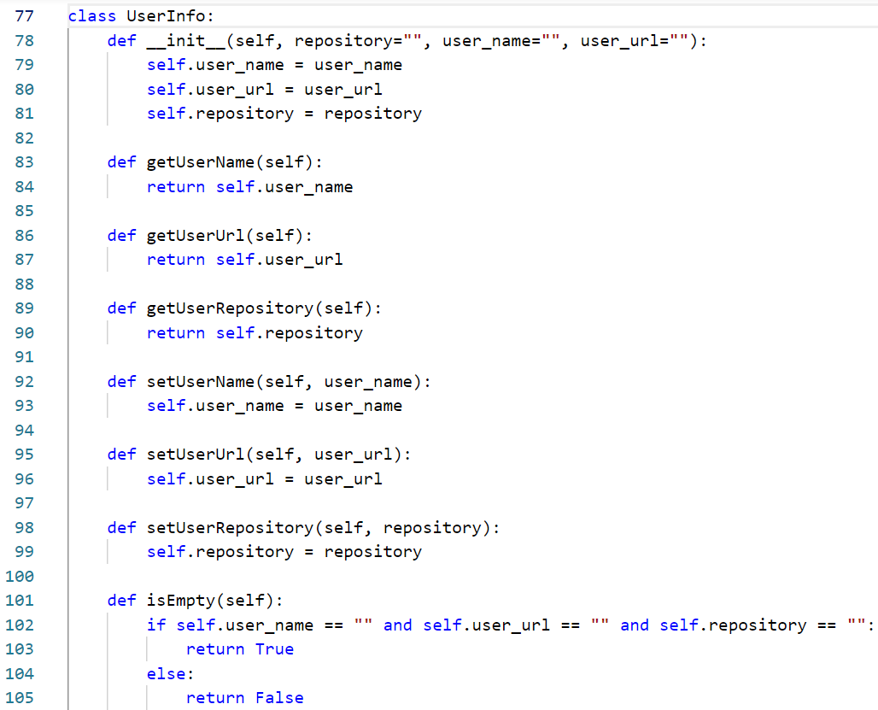
One thing to observe is that I have created a UserInfo object in code.
This is actually created to organize the data and create a matching entry for user repository, user url and user name.
This assists in creating a user defined data type and is used while creating a staging area.

Slide 42
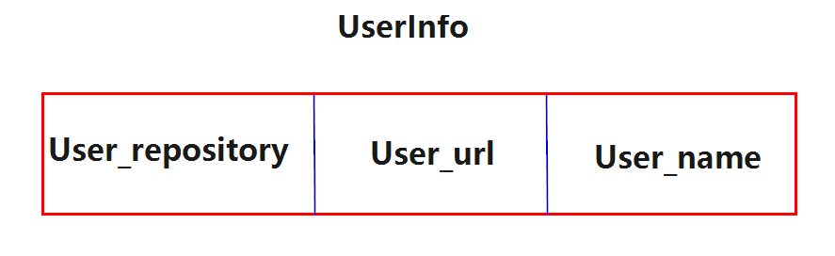
Structure of the UserInfo Object
The UserInfo object is composed of three other fields
User_repository
User_url
User_name

Slide 43
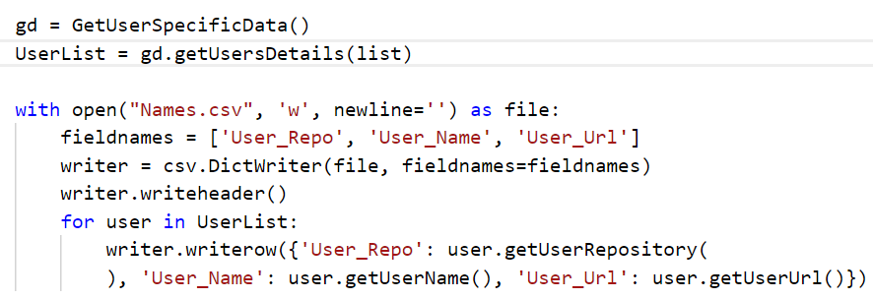
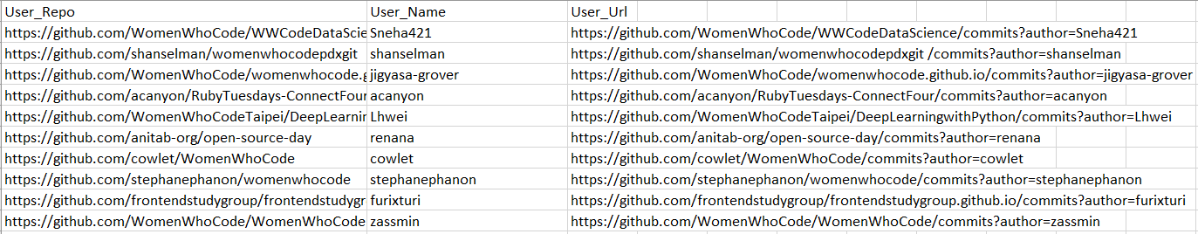
Extract module: Objective 3 → Creating a staging area

Slide 44
Why do we need a staging area
The staging area serves as a medium for other processes to interact with the scrapped data.
By using a staging area we can extract data once and use it over and over again for uploading and formulating a database.
Especially this can be useful while working on the development of the project.
In our case we use a csv file for staging.
Another advantage of staging area is that we can develop the logic for transform module in some other language such as Java.

Slide 45
Getting started with the Transform module
The Transform module also has some objectives.
To read the data present in the staging area
Creating a database generation script.
In our case we use graph databases
Hence, the transform module is used to generate a graph database creation script.

Slide 46
A gentle introduction to Graph databases
A graph database stores nodes and relationships instead of tables, or documents.
Data is stored just like you might sketch ideas on a whiteboard.
We live in a connected world, and understanding most domains requires processing rich sets of connections to understand what’s really happening.
Often, we find that the connections between items are as important as the items themselves.

Slide 47
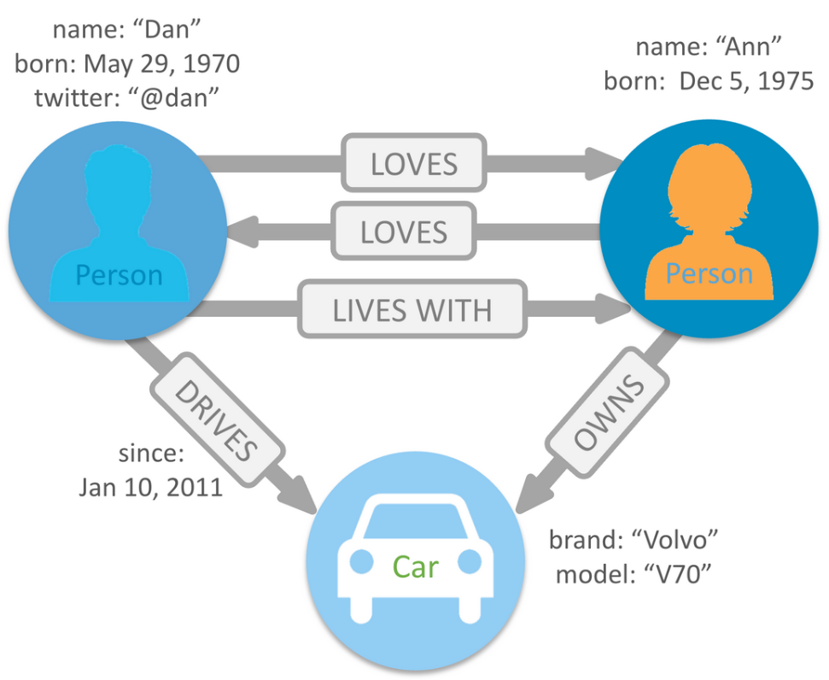
A graph database stores nodes and relationships.
Nodes and relationships store information as key-value pairs.
The data model is called as the property graph data model.

Slide 48
Cypher Query Language
Cypher is Neo4j’s graph query language that lets you retrieve data from the graph.
It is like SQL for graphs, and was inspired by SQL so it lets you focus on what data you want out of the graph (not how to go get it).
It is the easiest graph language to learn by far because of its similarity to other languages, and intuitiveness.
Cypher is unique because it provides a visual way of matching patterns and relationships.
Cypher uses ASCII art (:nodes)-[:relationships]->(:other_nodes)

Slide 49
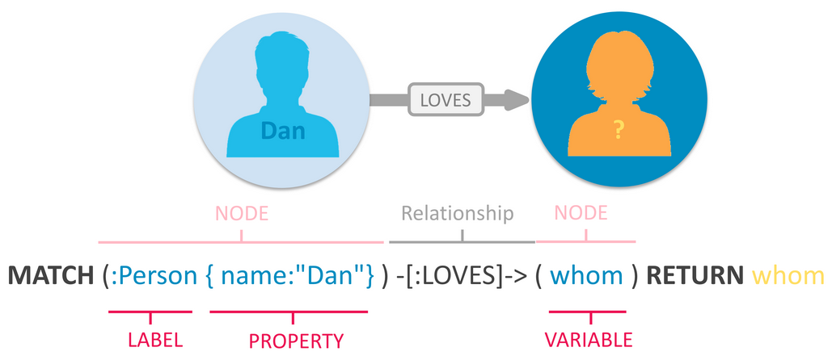
Cypher Query Language

Slide 50
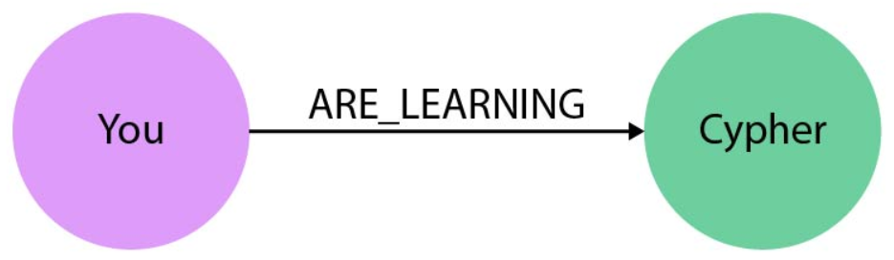
Cypher Query Language
As users we specify patterns.
Patterns are graphs that are specified by a user for extracting data from a graph database.
We can specify the following pattern
Match (You:PERSON)-[:ARE_LEARNING]->(Cypher:LANGUAGE)

Slide 51
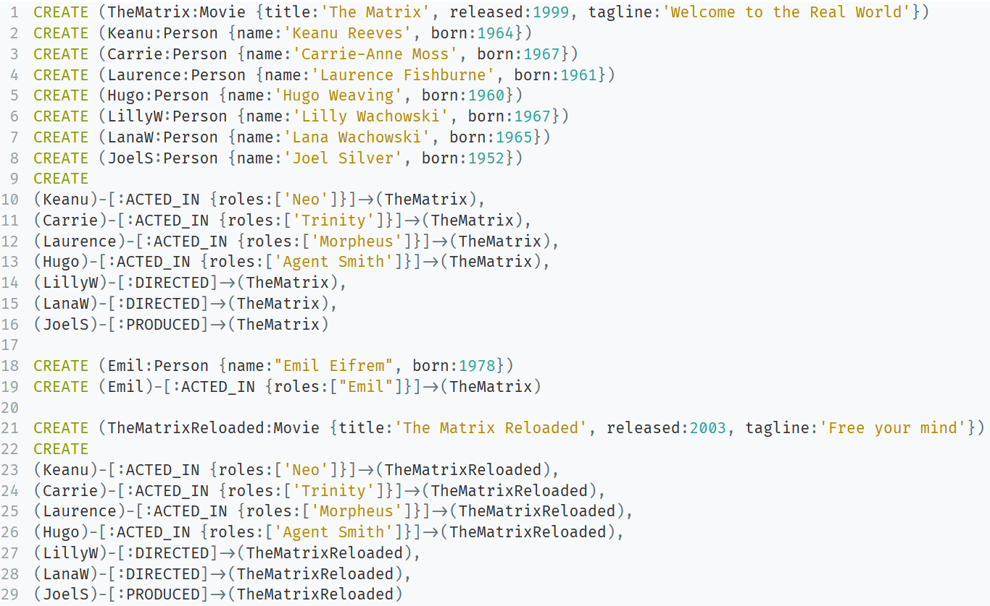
Cypher Query Language: Creating a Movie Database

Slide 52
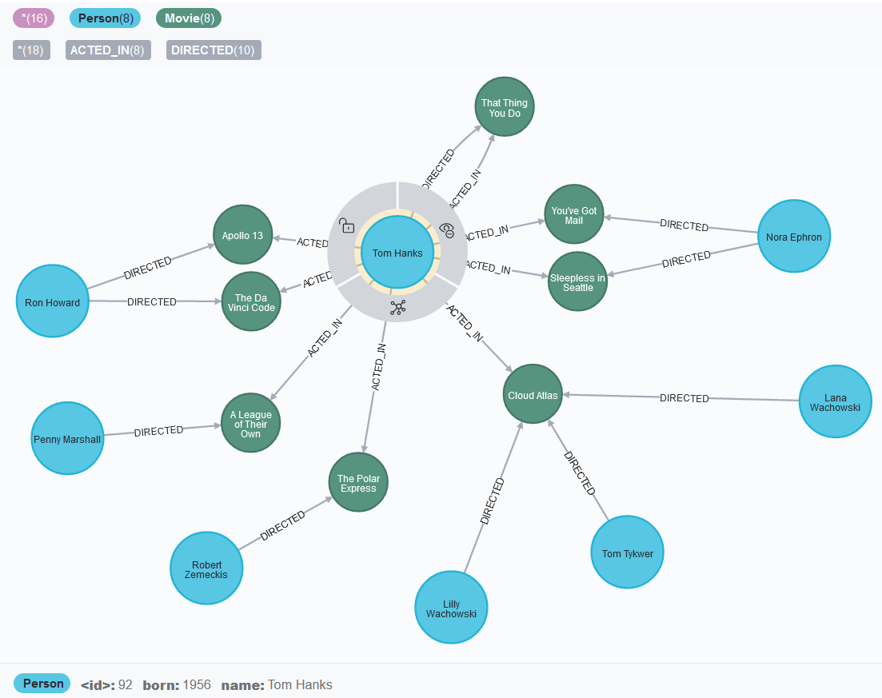

Slide 53
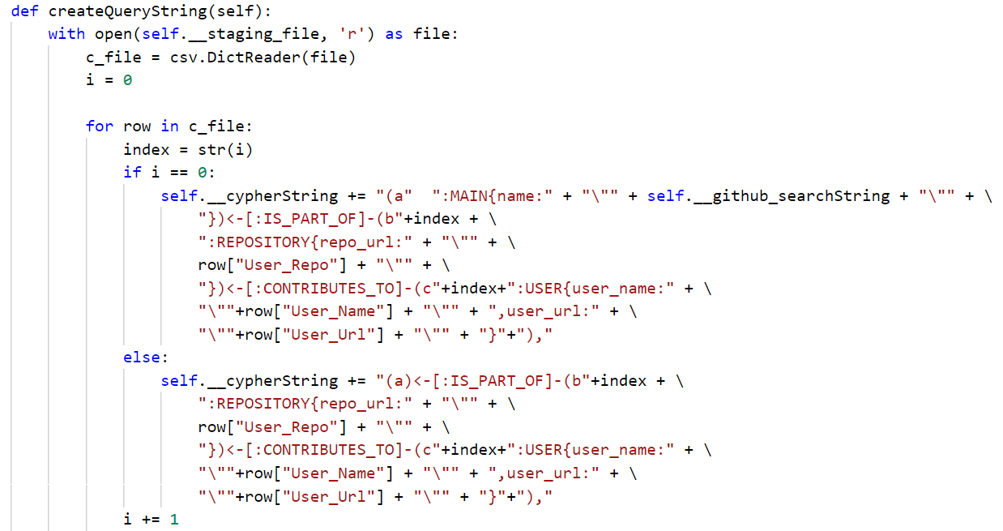
Transform module: Creating a database creation script

Slide 54
Load module: Creating the database
There are two main components of the Load module
Database connector
Database interface

Slide 55
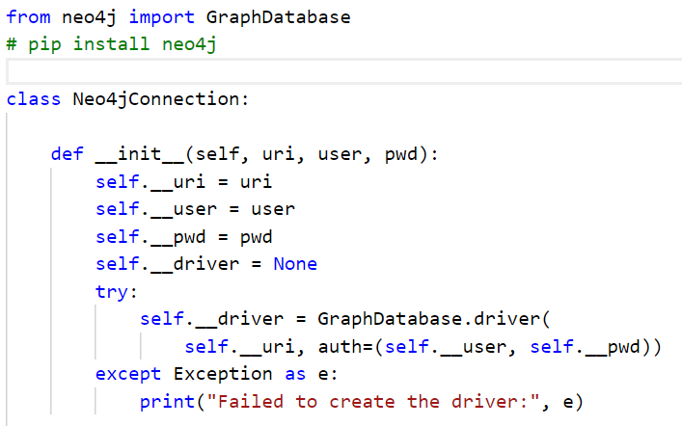
Database connector
Is the constructor for initializing the variables.
The code also uses a try-except block to check if a connection with database is established
Is case connection is not formed an exception is raised

Slide 56
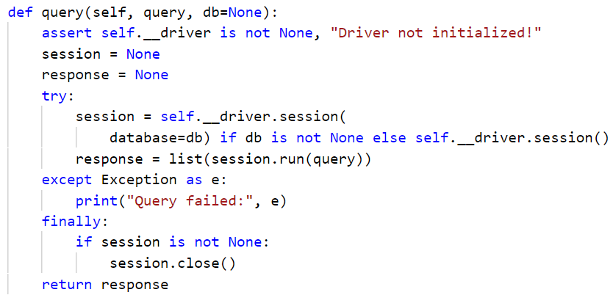
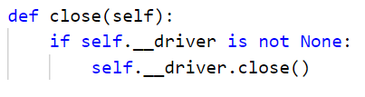
Database connector
The query function first asserts that a driver is initialized.
A session is formed by using the database driver. We also check if we are passing a particular database. Otherwise the default database that is running is selected.
We use the run method which is provided by the session class to run the query
Finally we use the close function to end the database connection

Slide 57
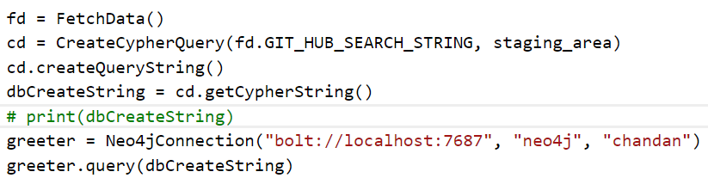
Database Interface
We instantiate the Fetch Data class
Next we instantiate the CreateCypherQuery class by passing the git hub search string and passing the staging area csv file.
Next we create the database creation string by calling the function

Slide 58
Database Interface
We store the database creation string in the dbCreateString variable.
We initialize the connection with
Neo4j Graph database by passing in the appropriate parameters such as url, user and password.
Finally we execute the query on Neo4j Graph Database

Slide 59
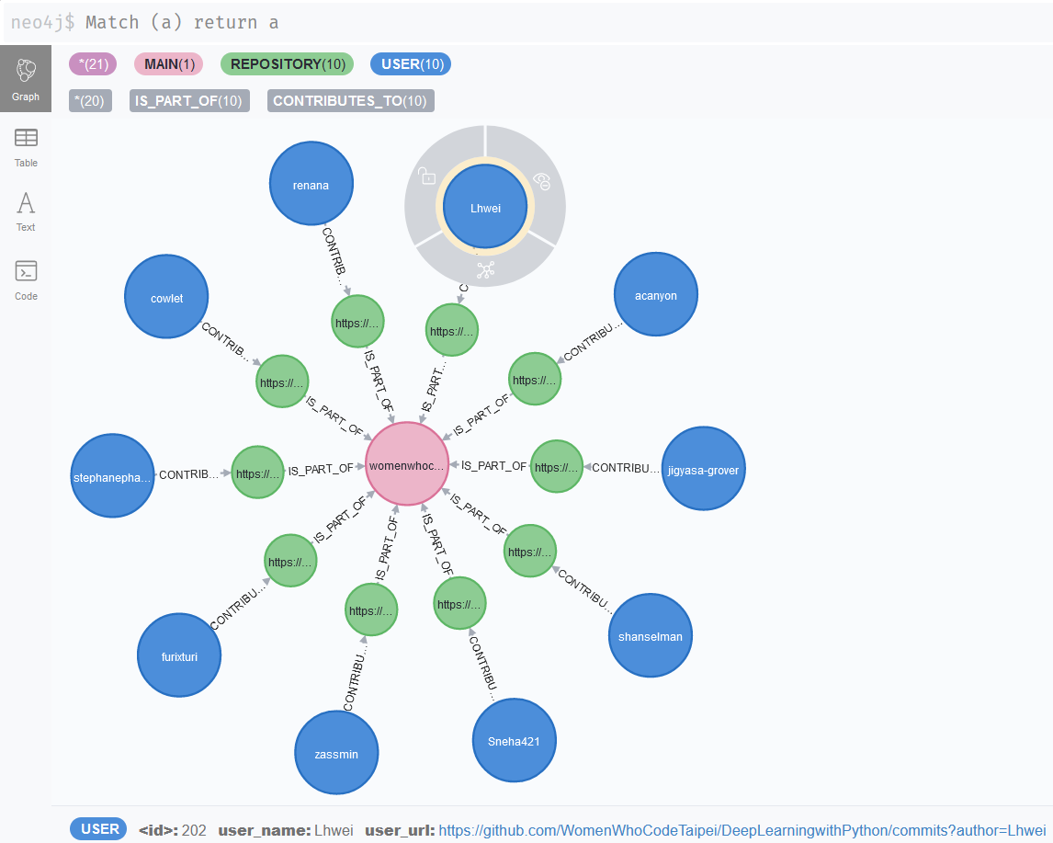

Slide 60
Creation of a Knowledge Graph
The knowledge graph can be created from the labeled property graph that we have.
We can create a social network of GitHub users by building on the logic that we have used to develop this software.
In its current form it is a Proof of concept.
Next objective:
Building a knowledge graph based on the graph database that we have.
This knowledge graph can be used to build recommendation system
The system can be used to provide recommendations to users that they can collaborate with.

Slide 61
Creation of a Knowledge Graph
Initial idea
We can use the GitHub api
We use the get method of GitHub api that provides us with information about users.
The syntax for the GitHub api’s get method is as follows:
https://api.github.com/users/{USER_NAME}
We have to pass the USER_NAME field of the url to fetch a record.
The result set produced is in form if a Json file.

Slide 62
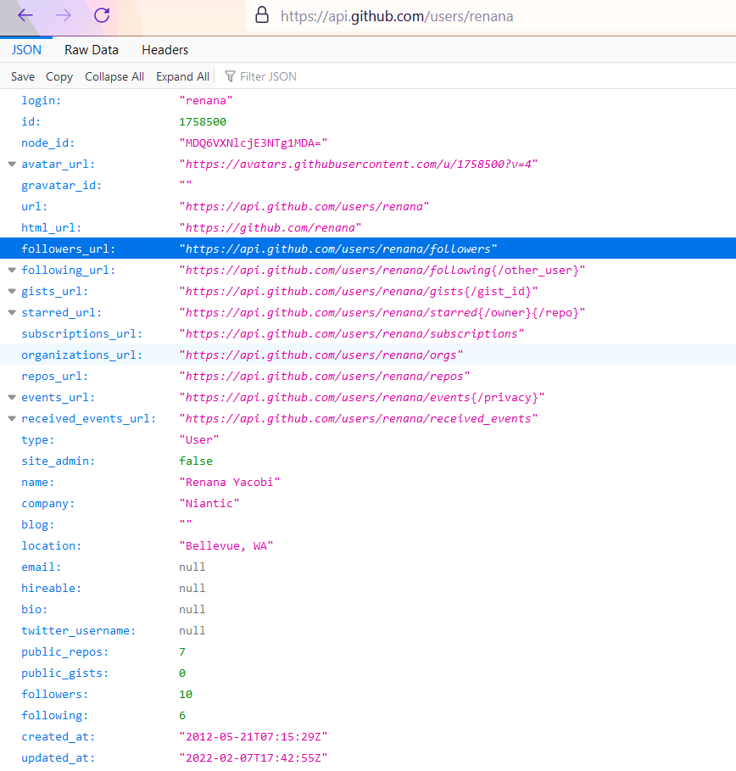
Open the browser and pass the url
The request returns all the information about the user. In case the user updates some thing on the GitHub repository such as added a new follower. The information gets updated on the api as well.
As such the get method is used to access the live data from GitHub.

Slide 63
Why using the get api method is a correct solution??
The only requirement for GET method in GitHub api is that a user name is required.
User name is unique identify of a GitHub user.
Our code already extracts user names of the users
We can use this to start building the knowledge graph

Slide 64
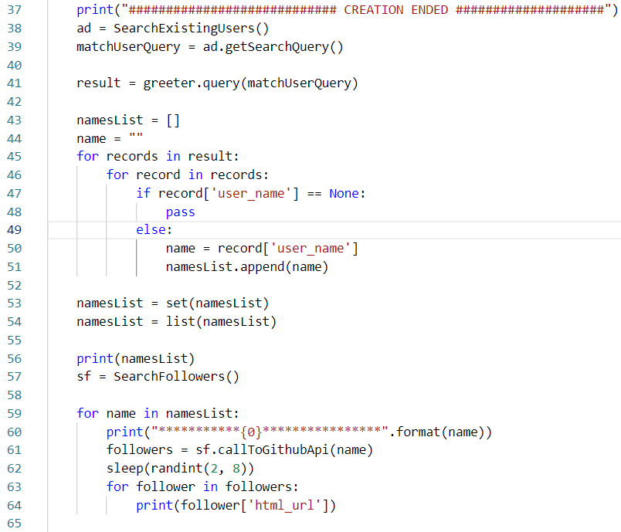
We are first searching all the users in the graph database that we have created.
Next we create a list of user names called as nameList
The nameList contains duplicated, so in order to eliminate the duplicates we convert the list into set and then set into a list.

Slide 65
We instantiate the class SearchFollowers and store the references in sf variable
Next we iterate over the nameList and pass each name to the callToGithubApi method in the SearchFollowers class.
The method returns a dictionary.
We iterate over the dictionary and output the follower’s html_url

Slide 66
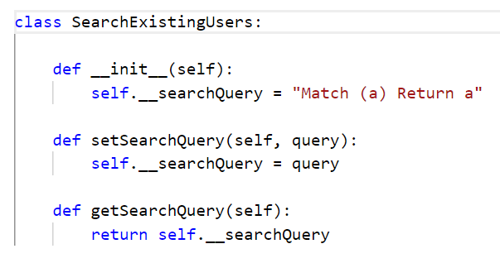
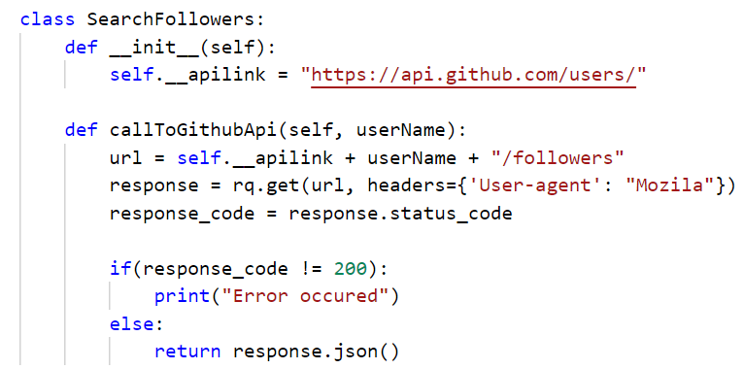
The SearchExistingUsers class initializes the searchQuery variable with a simple Cypher query.
The SearchFollowers class initializes an apilink
The callToGithubApi method appends username and followers to the url and then sends a get request.

Slide 67
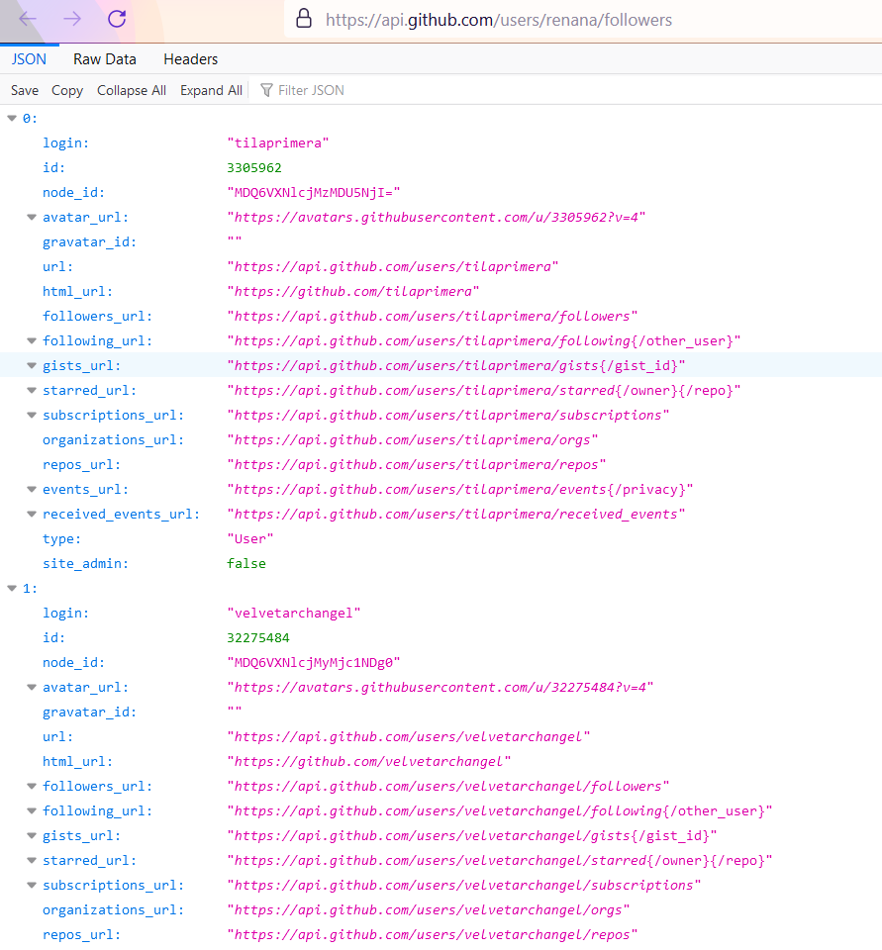

Slide 68
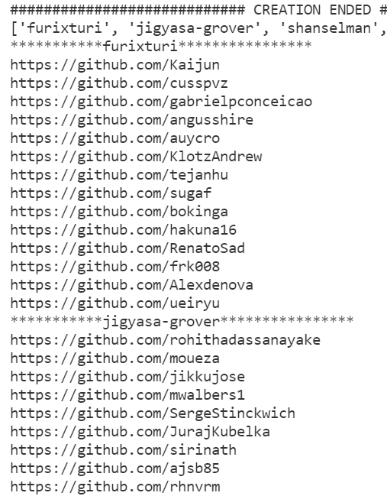
Using the python code discussed above we can now fetch all the followers data.
The output is displayed on the console.
We can use this information to start enriching our graph database. Hence creating a knowledge graph.

Slide 69
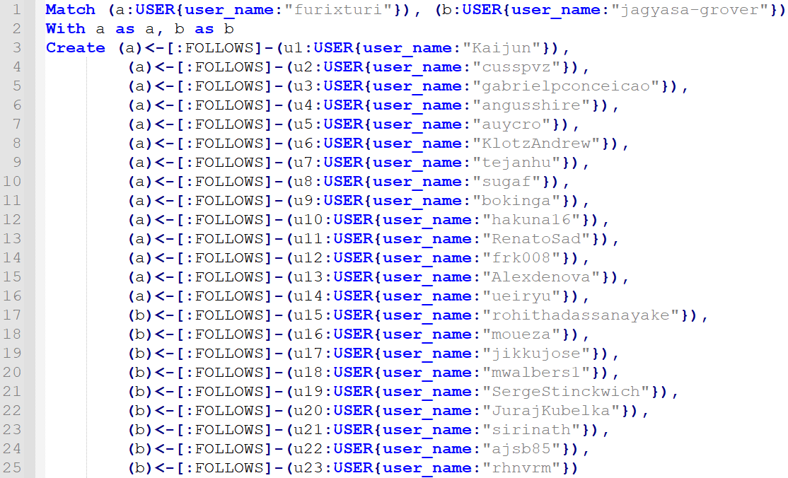
Cypher Query For Generating the Knowledge Graph

Slide 70
